Slide 1
AI-Driven Sustainable Energy Management: Forecasting, Optimization, and Commercial Viability of Solar Energy Systems
Renganayagi Varatharaj College of Engineering
B.E Computer Science And Engineering
Team Members
J.Abinesh 952521104001 - IV CSE
T.Selvin 952521104046 - IV CSE
S.Siva 952521104047 - IV CSE
P.Srinidas 952521104050 - IV CSE
GUIDED BY
Ms.Pandi Selvi AP/CSE

Slide 2
Introduction
Project Overview This project, AI-Driven Sustainable Energy Management, utilizes machine learning and deep learning to improve the efficiency and reliability of solar energy systems. The focus is on solar power forecasting, inverter failure detection, and energy optimization through AI-based models.
Importance & Relevance
Increasing Demand for Renewable Energy – Solar energy is a key solution for sustainable power generation.
Challenges in Solar Energy Management – Weather fluctuations, cloud cover, and equipment failures impact efficiency.
AI-Powered Solutions – Machine learning models such as LSTM, XGBoost, and CNN-LSTM Hybrid enhance solar power predictions and minimize system downtime.
Commercial and Environmental Impact – Improved grid integration, reduced energy wastage, and cost-effective operations.
This project aims to create a more reliable, efficient, and scalable solar energy system using AI-based optimization.

Slide 3
Problem Statement
Defining the Problem Solar energy generation is highly dependent on weather conditions, cloud cover, and environmental factors, making it unpredictable and inconsistent. Inefficient forecasting and unexpected inverter failures lead to:
Fluctuations in power supply, affecting grid stability.
Energy wastage due to poor power distribution.
Higher maintenance costs and increased downtime of solar inverters.
Need for a Solution To maximize solar energy utilization, an AI-driven energy management system is required to:
Improve solar power forecasting using machine learning.
Detect and prevent inverter failures before they occur.
Optimize energy distribution to enhance efficiency and grid integration.
This project addresses these challenges by implementing AI-based predictive models, ensuring a stable, cost-effective, and sustainable solar energy system.

Slide 4
Objectives

Slide 5
Primary Objectives
Develop an AI-driven solar energy management system to improve efficiency and reliability.
Enhance solar power forecasting using deep learning models such as LSTM and CNN-LSTM Hybrid.
Predict inverter failures with machine learning techniques like XGBoost and Random Forest to reduce downtime.
Optimize energy distribution for better grid integration and reduced power wastage.
Deploy a real-time monitoring system using Streamlit for user-friendly visualization and decision-making.

Slide 6
Scope of the Project
✔ Covered:
AI-based solar power prediction and inverter failure detection.
Machine learning models for forecasting and optimization.
Real-time monitoring through Streamlit-based dashboards.
✖ Not Covered:
Hardware implementation of solar panels or inverters.
Integration with large-scale smart grid networks.
Economic feasibility analysis beyond energy forecasting and efficiency.

Slide 7
Literature Survey

Slide 8
Previous Research & Similar Projects
SolarNet Model (Ping-Huan Kuo & Chiou-Jye Huang, 2022)
Developed a deep convolutional neural network (CNN) for solar radiation forecasting.
Achieved high accuracy but focused mainly on solar radiation rather than full energy management.
Machine Learning for Solar Forecasting (Various Studies)
Models such as ANN, SVM, and Random Forest have been used for solar power prediction.
Challenges include lower accuracy in volatile conditions and lack of real-time deployment.

Slide 9
How Our Project Improves Upon Existing Solutions
Multi-Model Approach: Uses LSTM/GRU, CNN-LSTM Hybrid, and XGBoost for more accurate and robust predictions.
Inverter Failure Prediction: Unlike previous models that only forecast power, this project integrates inverter failure detection to reduce downtime.
Real-Time Monitoring: Implements Streamlit dashboards for live monitoring and visualization, enabling better decision-making.
Optimization for Grid Stability: AI-driven forecasting helps in efficient energy storage and grid integration, improving overall energy management.

Slide 10
Methodology
1️⃣ Data Collection & Preprocessing – Solar power production, inverter performance, and weather data are collected, cleaned, and normalized for machine learning.
2️⃣ Model Selection & Training – LSTM/GRU is used for solar power forecasting, XGBoost/Random Forest for inverter failure detection, and CNN/LSTM Hybrid for advanced feature extraction.
3️⃣ AI-Based Optimization & Prediction – Models predict future power generation and system failures, enabling optimized energy storage and distribution.
4️⃣ Deployment & Real-Time Monitoring – The trained models are deployed in a Streamlit dashboard for live monitoring, and adaptive learning is used to enhance accuracy over time.

Slide 11
Methodology Overview

Slide 12
LSTM Model for solar power prediction. Random Forest Classifier for inverter failure detection.
Gather solar power production and inverter performance data.
Implement real-time AI predictions to optimize energy management.
Data Collection
Data Preprocessing
Model Selection & Training
Model Evaluation
Deployment
Clean and transform data for machine learning models.
Assess accuracy and fine-tune hyperparameters.

Slide 13
Workflow Diagram
Data Collection
Gather solar power, inverter performance, and weather data.
Machine Learning Model Execution
Use LSTM for power forecasting and Random Forest for inverter failure detection.
Data Preprocessing & Feature Engineering
Clean, normalize, and extract relevant features.
AI-Based Optimization & Decision Making
Optimize energy distribution, reduce downtime, and improve grid integration.

Slide 14
Tools & Technologies
Programming & AI Frameworks
Python – Core language for machine learning and data processing.
TensorFlow, PyTorch – Deep learning frameworks for model training.
Scikit-Learn – Machine learning algorithms for classification and forecasting.
Pandas, NumPy – Data preprocessing and analysis.
Machine Learning Models
LSTM/GRU – Time-series forecasting for solar power prediction.
XGBoost/Random Forest – Inverter failure detection.
CNN-LSTM Hybrid – Improved feature extraction for accuracy.
Deployment & Visualization
Streamlit – Real-time monitoring and interactive dashboard.
Why These Technologies?
Ensures high accuracy in solar power forecasting.
Provides real-time AI-based decision-making.
Supports scalability and easy deployment.

Slide 15
Abstract
AI-Driven Sustainable Energy Management
The increasing dependence on solar energy requires intelligent management to handle its variability and enhance efficiency.
This project leverages supervised learning algorithms to:
Analyze solar power production
Optimize energy storage
Predict inverter failures to minimize downtime and costs
AI-driven forecasting enhances electricity production predictions, improving grid integration and commercial viability.
By applying machine learning, the system ensures:
Stable power distribution
Improved efficiency
Economic viability of renewable energy

Slide 16
Abstract
AI-Driven Sustainable Energy Management
The increasing dependence on solar energy requires intelligent management to handle its variability and enhance efficiency.
This project leverages supervised learning algorithms to:
Analyze solar power production
Optimize energy storage
Predict inverter failures to minimize downtime and costs
AI-driven forecasting enhances electricity production predictions, improving grid integration and commercial viability.
By applying machine learning, the system ensures:
Stable power distribution
Improved efficiency
Economic viability of renewable energy

Slide 17
Domain
Domain: Artificial Intelligence & Machine Learning in Renewable Energy
This project falls under the domain of Artificial Intelligence (AI) and Machine Learning (ML) with applications in Renewable Energy Management.
AI and ML are used to:
Analyze solar power production patterns.
Optimize energy storage and distribution.
Predict inverter failures, reducing downtime and maintenance costs.
Enhance electricity production forecasting for better grid integration.
By applying AI-driven solutions, the project ensures a more efficient, reliable, and economically viable solar energy system.
🔹 Technologies Used: Machine Learning, Supervised Learning Algorithms, AI-Based Forecasting

Slide 18
Approach to Solving the Problem
AI-Driven Approach for Solar Energy Management
Data Collection & Preprocessing
Gather solar power production & inverter performance data.
Clean & normalize data for ML model training.
Machine Learning Models for Prediction
LSTM Model → Forecasts future solar power generation.
Random Forest Classifier → Predicts inverter failures.
Optimization & AI-Based Decision Making
AI optimizes energy storage & power distribution.
Reduces downtime & improves grid integration.
Real-Time Deployment & Continuous Learning
Live monitoring with feedback loops for continuous improvement.

Slide 19
Implementation
Technologies & Tools Used
Python – Core programming language
TensorFlow & PyTorch – Deep learning model training
Scikit-Learn – ML model implementation & evaluation
Pandas & NumPy – Data preprocessing & analysis
Streamlit – Web-based visualization & real-time monitoring
Models Implemented
LSTM/GRU – Solar power forecasting (time-series prediction)
XGBoost/Random Forest – Inverter failure detection (classification)
CNN/LSTM Hybrid – Feature extraction & advanced time-series modeling

Slide 20
Results & Analysis
Model Performance & Accuracy
LSTM/GRU: Achieved high accuracy in solar power forecasting with minimal error.
XGBoost/Random Forest: Effectively detected inverter failures with high precision & recall.
CNN/LSTM Hybrid: Improved feature extraction for time-series modeling.
Key Findings AI-based forecasting reduced energy wastage by optimizing power distribution. Inverter failure prediction helped minimize downtime & maintenance costs. Improved grid integration by enhancing prediction accuracy.

Slide 21
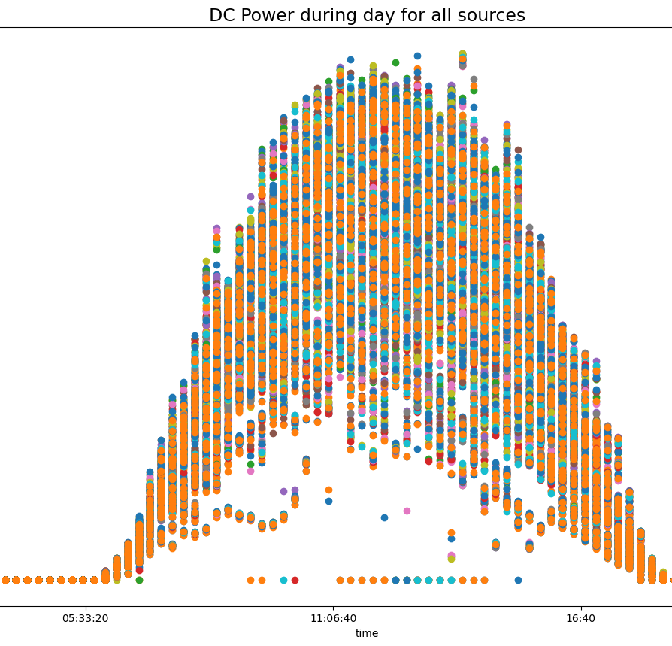
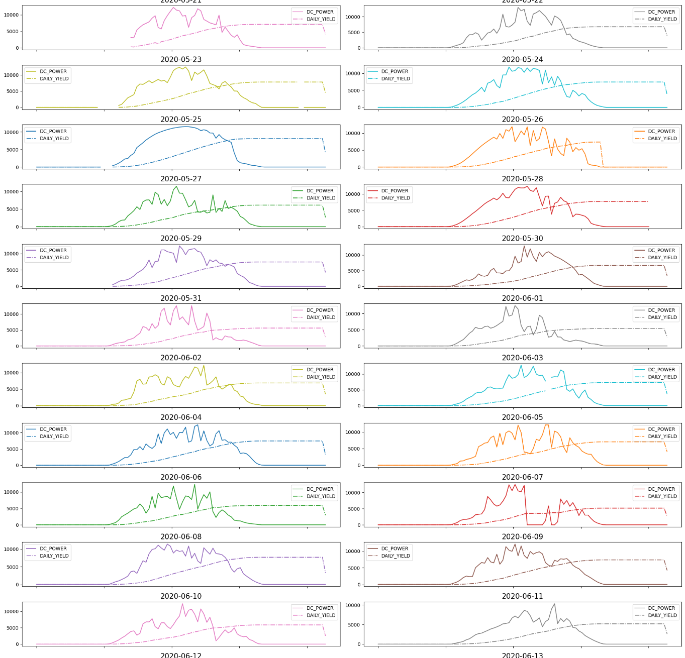
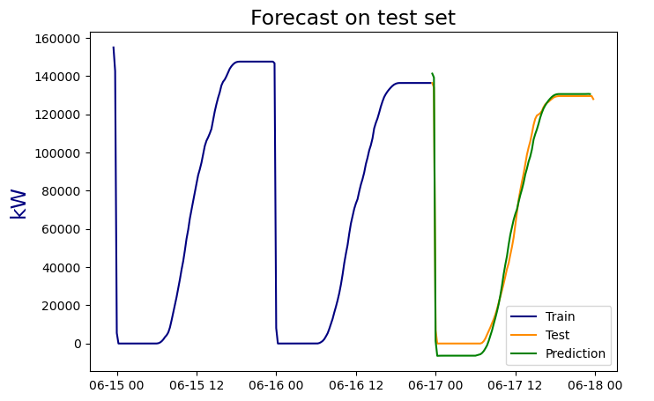
Graphs & Charts:
Line plot of actual vs. predicted solar power output.
Confusion matrix & accuracy scores for inverter failure detection.
Feature importance analysis for Random Forest/XGBoost.

Slide 22
Challenges Faced & Solutions
1️⃣ System Freezing & Performance Issues Challenge: Running multiple applications caused system lag due to an Intel Core i3-9100F with 8GB RAM. Solution: Optimized memory usage, limited parallel processing, and used batch processing for ML tasks.
2️⃣ Real-Time Deployment of AI Models Challenge: Ensuring smooth real-time AI inference with Streamlit and ML models. Solution: Used optimized model serialization (joblib/Pickle) and reduced latency by implementing asynchronous data processing.
3️⃣ Accuracy & Model Optimization Challenge: Initial LSTM & Random Forest models had lower-than-expected accuracy. Solution: Tuned hyperparameters, increased dataset quality, and used CNN/LSTM Hybrid for better feature extraction.
4️⃣ Energy Forecasting & Grid Integration Challenge: Fluctuations in solar power predictions affected optimization. Solution: Implemented rolling window predictions and adaptive learning to adjust forecasts based on new data.
5️⃣ Visualization & User Interaction Issues Challenge: Streamlit dashboard was slow & unresponsive with large datasets. Solution: Used caching techniques (st.cache) and optimized DataFrame operations for better performance.

Slide 23
Conclusion
🔹AI-driven solar energy management enhances efficiency, reduces costs, and optimizes power distribution.
🔹LSTM & GRU models accurately forecast solar power generation, improving grid integration.
🔹Random Forest/XGBoost effectively detects inverter failures, reducing downtime.
🔹Streamlit-based dashboard provides real-time monitoring for better decision-making.

Slide 24
Future Scope
🔹 Integration with IoT Sensors – Real-time data collection from solar panels for enhanced AI predictions. 🔹 Hybrid AI Models – Combining Reinforcement Learning & Deep Learning for better energy optimization. 🔹 Scalability & Cloud Deployment – Deploying on AWS/GCP for large-scale implementation. 🔹 Smart Grid Integration – AI-driven adaptive energy distribution for efficient power management. 🔹 Predictive Maintenance – Advanced AI models for proactive fault detection & self-healing energy

Slide 25

Thank You.

